Slide 1
Notes:
1. Home Page: ○ Display an overview of the website, highlighting key features, offers, and search functionality.

Slide 2
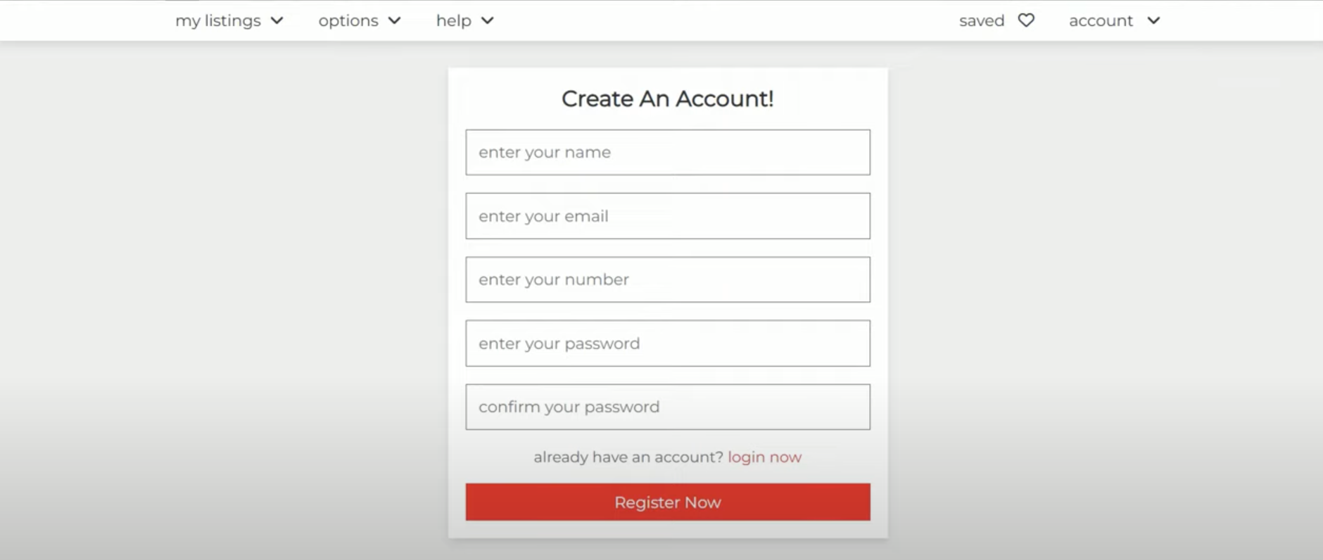
Register Now
Notes:
2. User Registration & Login Page: ○ Allow users to register or login to their accounts.

Slide 3
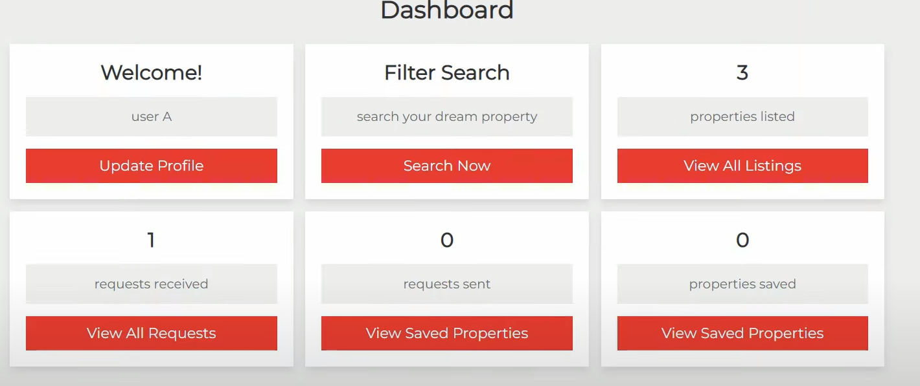
User Profile Dashboard
Update Profile
View Saved Properties
View All Offers Received
View All Offers Sent
View All My Listings
Notes:
3. User Profile Page: ○ Enable registered users to modify their profile details.

Slide 4
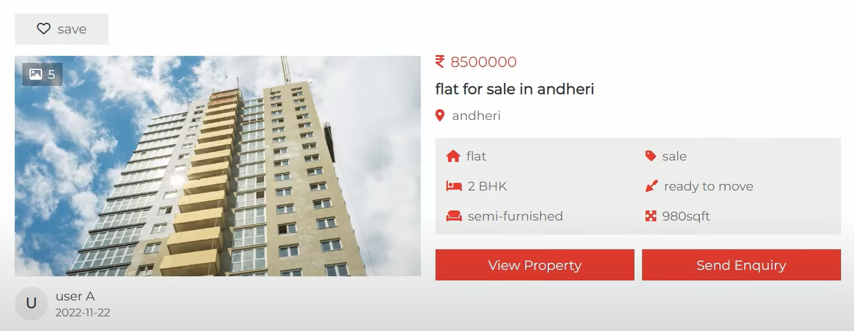






All Listings
$ 850,000.00
Apartment for Sale in Hawaii
Hawaii
View Property
Send Enquiry
$ 1.220,000.00
House for Sale in Hawaii
Hawaii
View Property
Send Enquiry
Notes:
4. Accommodation Listings Page: ○ Display a list of accommodations with essential information like address, description, listing agent, and price.

Slide 5
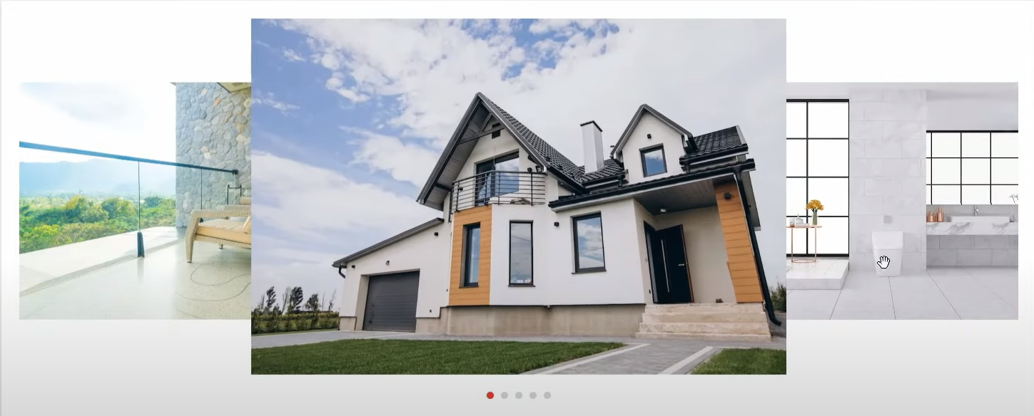

Property Details
$ 850,000.00
House for Sale in Hawaii
info Abc info Cde info Zwy info Cde info Zwy
Save Property
Send Offer
Save Property
Details
Info …
Info ….
Info ….
Info ….
Notes:
5. Accommodation Details Page: ○ Provide detailed information about a specific accommodation, including images and additional details. ○ Allow users to submit an offer for a particular accommodation.

Slide 6
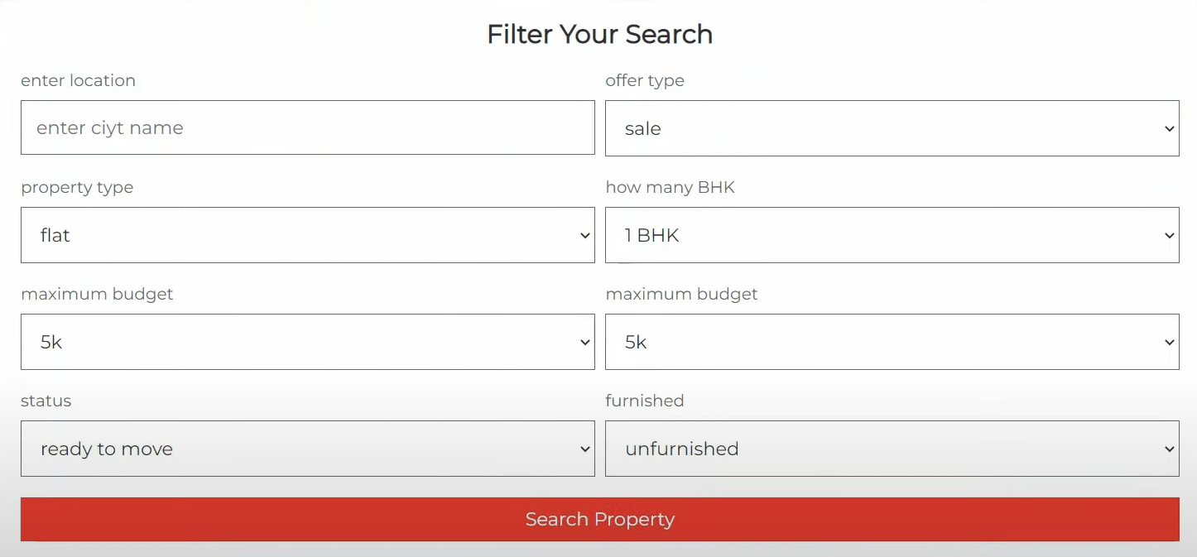
Search Property
Notes:
6. Search Results Page: ○ Show search results based on user input with the option to filter the results

Slide 7
Send Offer
Property ID: cs1324
Asking Price: $1.022.980,00
Offer:
Please enter amount
Send Offer
Your offer is $111.00 (above or below) the asking price.
Would you like to continue?
YES
NO
Notes:
7. Checkout Page: ○ Confirm the offer with the user and indicate how much it is above or below the asking price.

Slide 8
Notes:
8. Admin Panel: ○ Provide access to administrative functions to manage users, agents, properties, and offers.

Slide 9
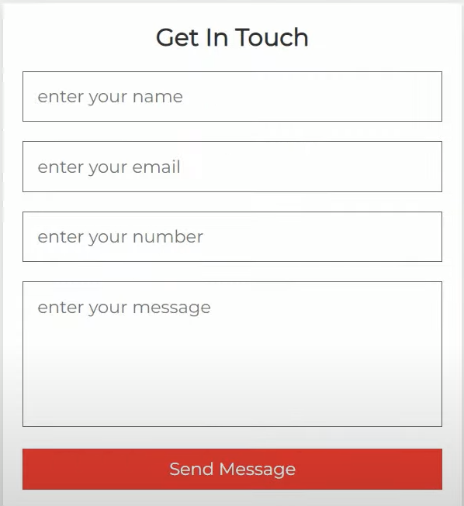

Send Message
Information about our group/topic
How to contact the company and/or where they are located
Notes:
9. Contact us Page: ○ Information about our group/topic ○ How to contact the company and/or where they are located

